Slide 1

Earthquake Depth
and Magnitude Prediction using Deep Learning
Authors:
Mayank Panwar (2022UCA3114)
Saurabh (2022UCA1926)
Mohd. Imaad (2022UCA1941)

Slide 2

Introduction
Earthquakes are highly unpredictable and often devastating.
Traditional methods rely on physical sensors and statistical techniques.
Deep learning leverages large-scale data for improved predictive accuracy.
This project focuses on predicting earthquake magnitude and depth using Dense Neural Network and LSTM models.

Slide 3

Problem Statement
Accurately predicting earthquake intensity and depth is a major scientific challenge.
Seismic data is complex: high-dimensional, time-based, and noisy.
The goal is to build a robust, data-driven system that can predict two target variables:
Magnitude (how strong)
Depth (how deep under surface)

Slide 4

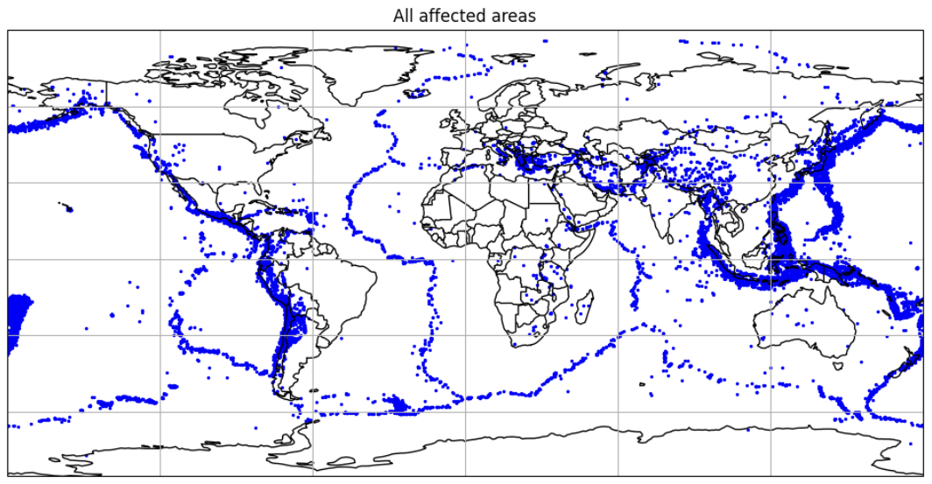
Objective
Predict earthquake magnitude and depth using geospatial data.
Compare different deep learning models:
Dense Neural Networks (3 variants)
LSTM-based Model
Evaluate and visualize spatial prediction performance.

Slide 5

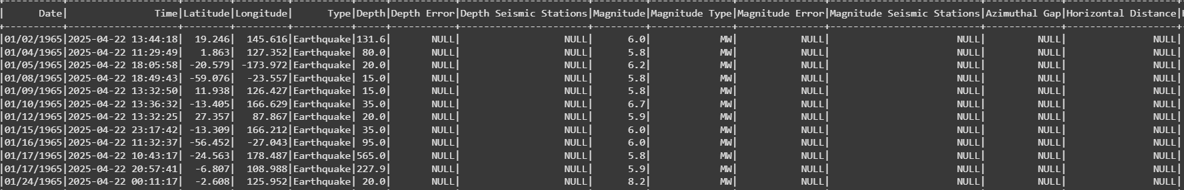
Dataset Overview
Source: USGS Earthquake Database
Link :- https://www.kaggle.com/datasets/usgs/earthquake-database
Total records: 23,595 earthquake events
Features used:
Latitude, Longitude, Time, Depth, Magnitude
Period Covered: 1965-2016

Slide 6

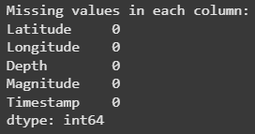
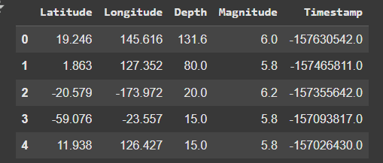

Data Preprocessing
Removed missing/incomplete records
Normalized numerical features
Feature Engineering (Time converted to numerical index)
Train-Test Split: 80/20

Slide 7
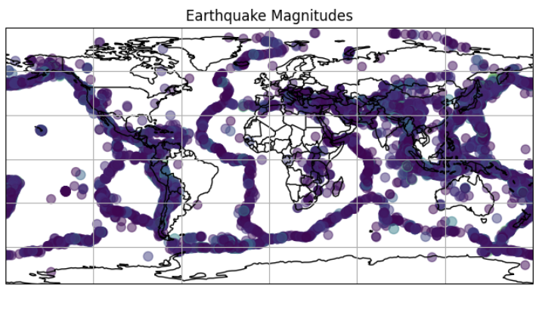

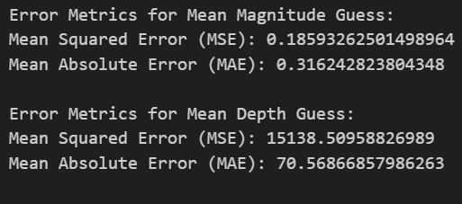
Prediction Targets
Multi-output regression task
Target 1: Magnitude (Richter scale)
Target 2: Depth (in km)
Typical Ranges:
Magnitude: 3.5 to 8.5
Depth: 0 to 700 km

Slide 8

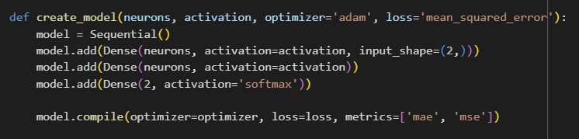
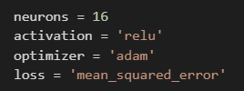
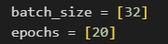
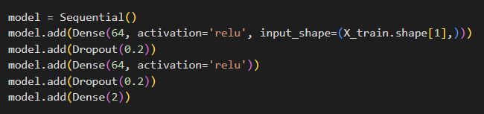
Model 1 – Dense Neural Network (Simple)
Architecture: Input → Dense(16) → Dense(16) → Dense(2)
Loss Function: MSE
Activation:Softmax
Optimal approach

Slide 9
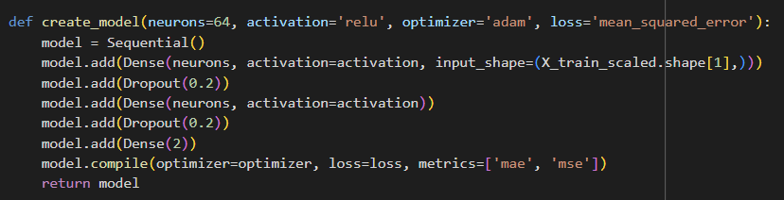
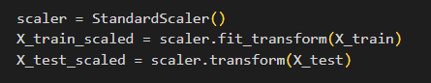
Model 2 – Deeper Dense Neural Network
Architecture: Input → Dense(64) → Dropout(0.2) → Dense(64) → Dropout(0.2) → Dense(2)
Early stopping to avoid overfitting

Slide 10
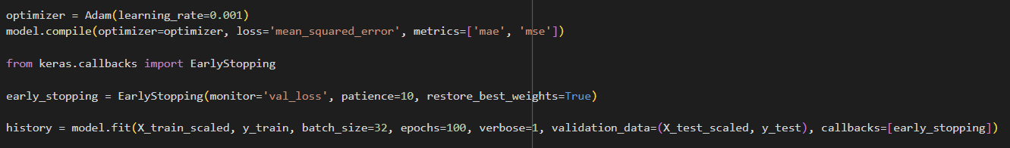
Model 3 – Dense NN with Batch Normalization
Architecture: Input → Dense(64) → BatchNorm → Dropout → Dense(32) → BatchNorm → Dense(2)
Benefits: faster convergence and stability

Slide 11
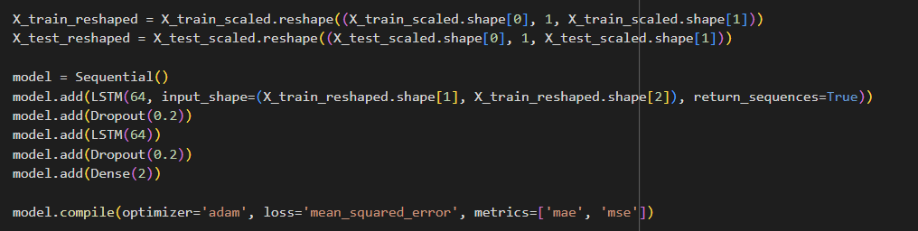
Model 4 – LSTM-based Network
Architecture: Input (reshaped) → LSTM(64) → Dropout → LSTM(64) → Dense(2)
Captures temporal patterns and dependencies

Slide 12
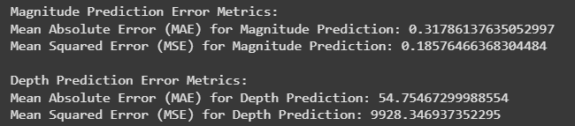
Evaluation Metrics
MAE (Mean Absolute Error): measures average error
MSE (Mean Squared Error): penalizes large deviations

Slide 13
Model Performance Comparison
Model | MAE (Mag) | MAE (Depth) | MSE (Mag) | MSE (Depth)
Dense 1 | 0.3096753 | 11374.84 | 0.191776 | 59.23760
Dense 2
Dense 3 | 0.3384406 | 11284.58 | 0.191242 | 60.78193
LSTM | 0.3178613 | 9928.346 | 0.185764 | 54.75467

Slide 14
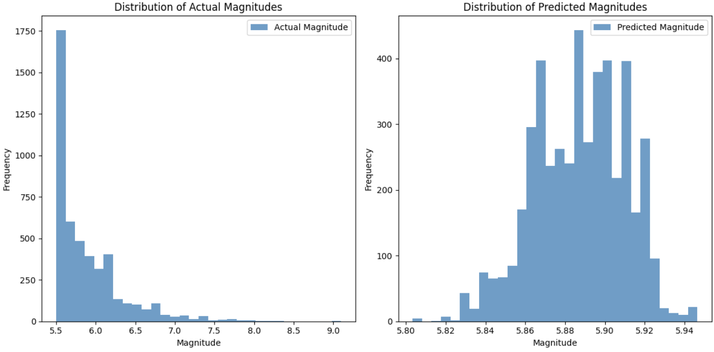
Distribution of Predicted vs Actual Magnitude

Slide 15
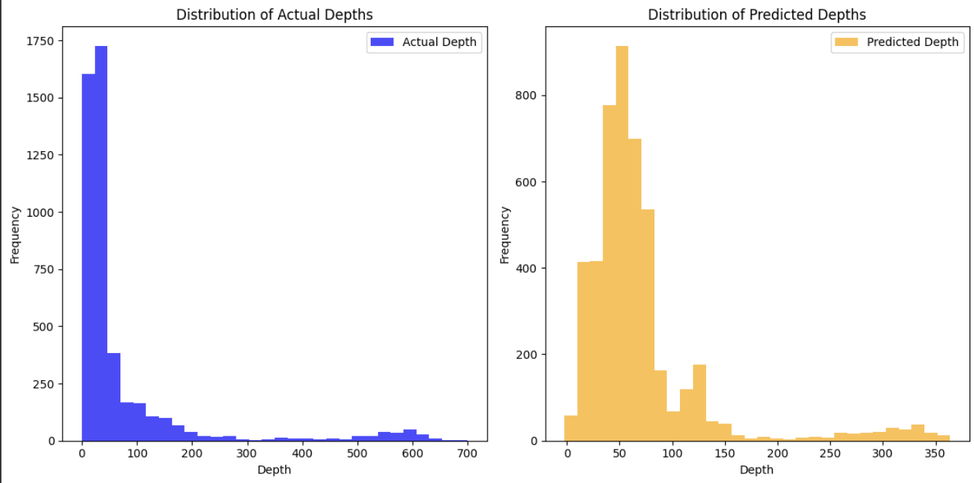
Distribution of Predicted vs Actual Depth

Slide 16
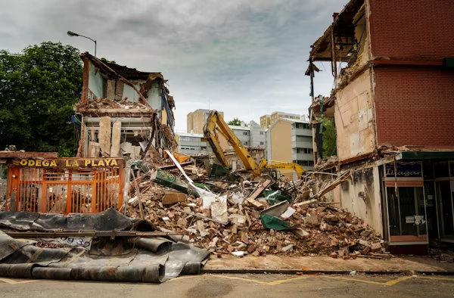
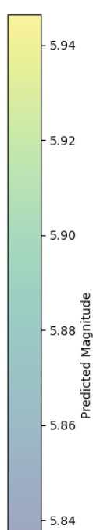
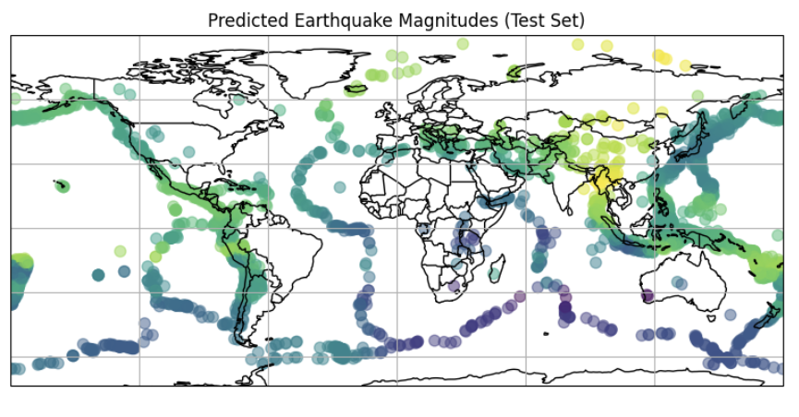
Geospatial Visualization – Predicted Magnitudes

Slide 17
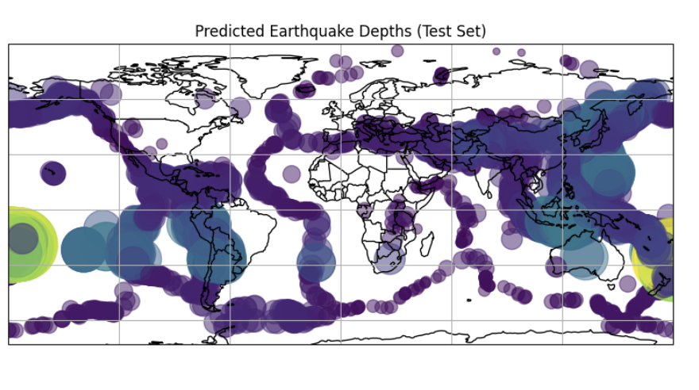
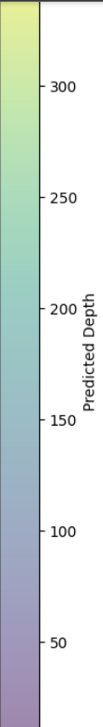
Geospatial Visualization – Predicted Depth

Slide 18
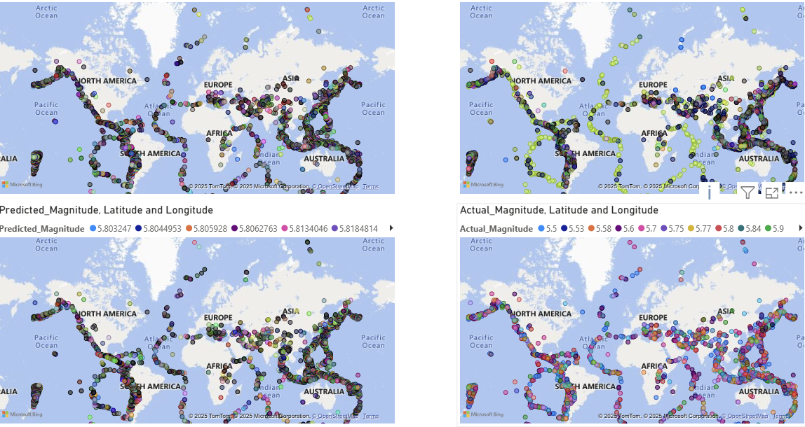
Dashboard

Slide 19
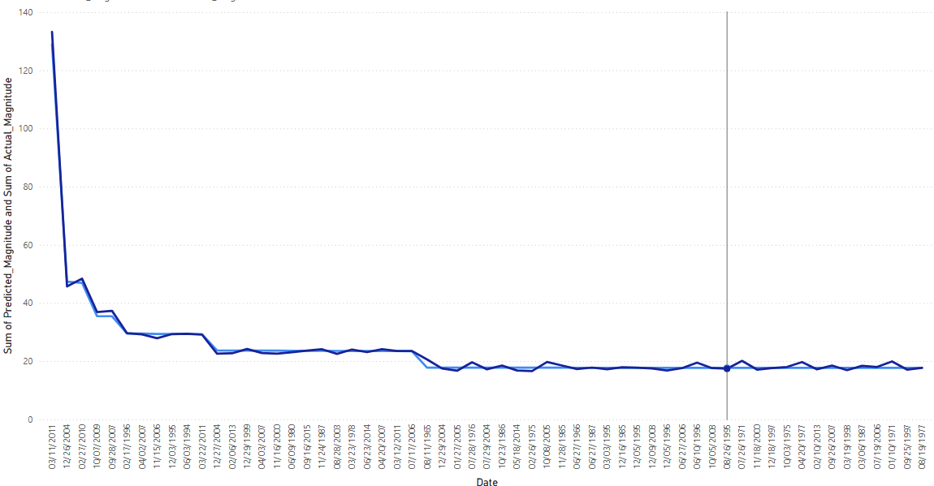
Dashboard

Slide 20
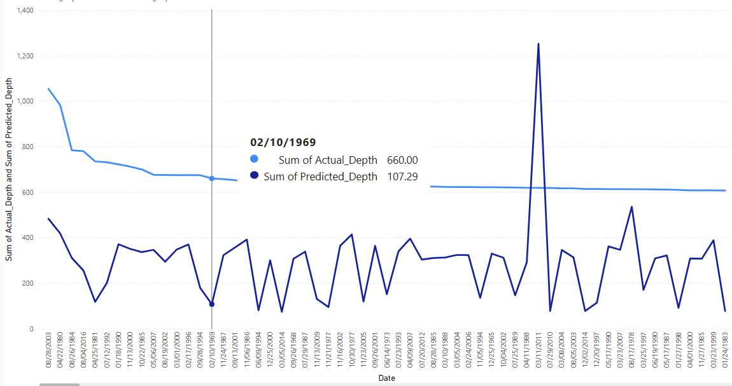
Dashboard

Slide 21
Conclusion
Dense and LSTM models effectively predicted magnitude
Depth predictions are inherently more variable
LSTM slightly outperformed others
Visualization helps in spatial interpretation

Slide 22
Future Scope
Integrate seismic waveform features (P and S waves)
Use satellite or remote-sensing data
Implement Bayesian Neural Networks for uncertainty estimation
Real-time deployment via API

Slide 23
References
Joshi et al. (2024), “Data-Driven Earthquake Systems,” JAG
Jain et al. (2021), “Seismic Earthquake Prediction using ML,” J. Earthquake Engg.
Wang et al. (2023), “Deep Learning for Seismic Forecasting,” SRL
Sadhukhan et al. (2023), “Hybrid NN for Earthquake Prediction,” IJG

